Slide 1

A PRESENTATION ON
CAR RENTAL
SYSTEM
Prepared by: Subash Gurung, Rikita Gharti, Namrata Bastola, R.A.Mon Tiwari

Slide 2
Fleet-Ease, the ultimate solution for car rental management
Fleet-Ease combines efficiency and convenience, ensuring reliable operations
Meets the diverse needs of Rental agencies
Utilizing performance optimization strategies for seamless operation, Fleet-Ease ensures a smooth and efficient rental process
INTRODUCTION​

Slide 3
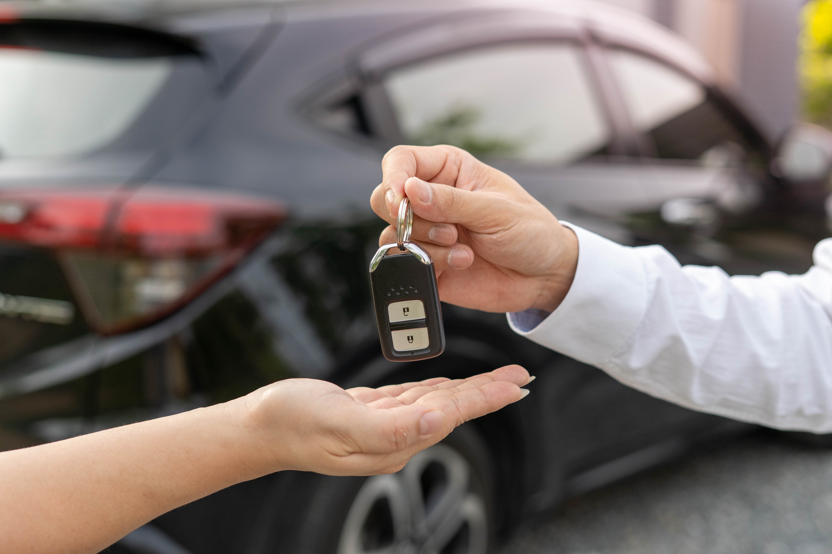
PROBLEMS
Inefficient Manual Processes​
Economic Efficiency​
Poor Customer Experience
Complex Interface
Lack of Delivery Options
Limited Accessibility

Slide 4

OBJECTIVES
Easiness in Rental Processes​
Enhanced User Experience​
Real-time Availability Updates​
Secure Data Management​
Cost Efficiency

Slide 5
Our Requirements
Functional Requirements
User Registration and Authentication
User Management with User Types
Car Inventory Management
Rental Management
Non- Functional Requirements
Performance
Reliability
Security
Technologies Requirements
Vb.net Programming Language
Visual Studio 2022
Microsoft SQL

Slide 6

DEVELOPMENT
MS POWERPOINT:
For Presentation slides
ADOBE PHOTOSHOP:
For graphical logos
DISCORD:
For meetings
DRAW.IO:
For Diagrams
MS WORD:
For Gantt Chart
VISUAL STUDIO 2022:
For coding
For DATABASE
MSQL:

Slide 7
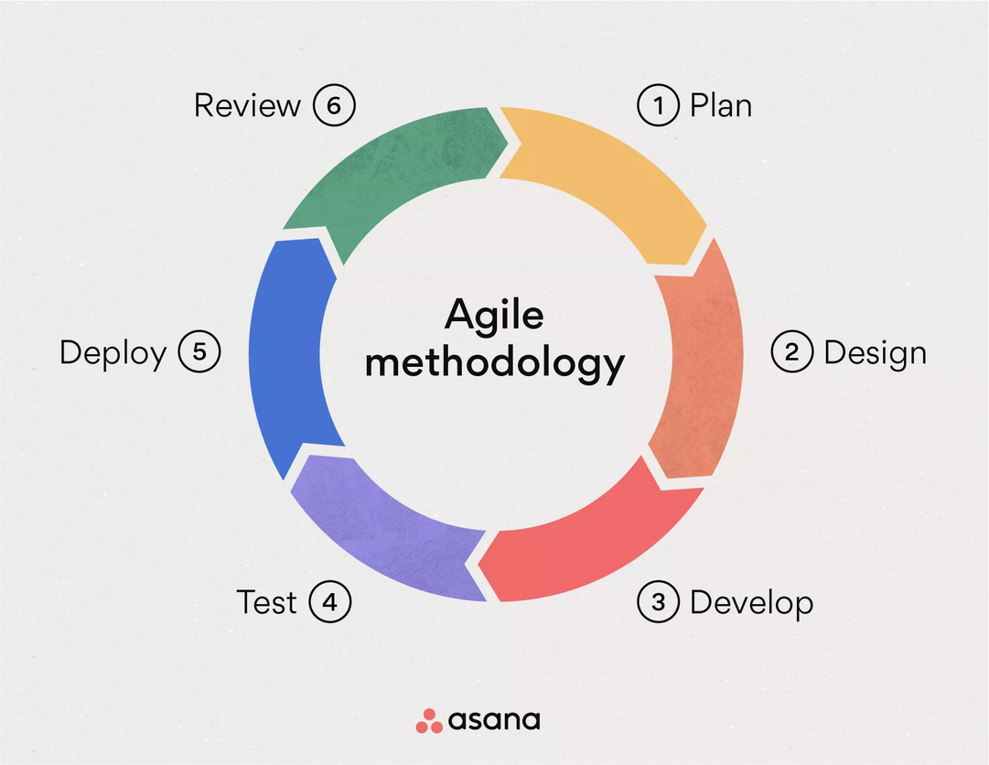
METHODOLOGY
Agile methodologies emphasize iterative development, collaboration, and flexibility in response to changing requirements.
Allows for frequent feedback loops, early delivery of working software, and close collaboration between the coder and documentation team.

Slide 8
METHODOLOGY
The coder can work in short development sprints (e.g., 1-2 weeks) to deliver specific features while the documentation team prepares and updates documentation based on evolving software features.
Use project management tools like Jira or Trello for sprint planning, task tracking, and collaboration.

Slide 9
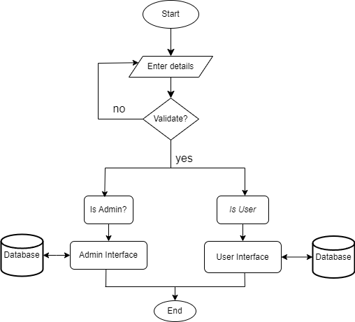
FLOWCHART I:

Slide 10
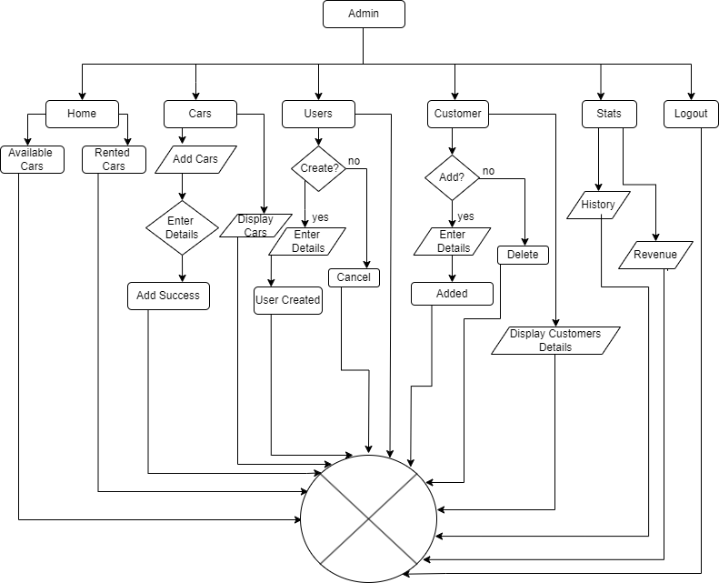
FLOWCHART II:

Slide 11
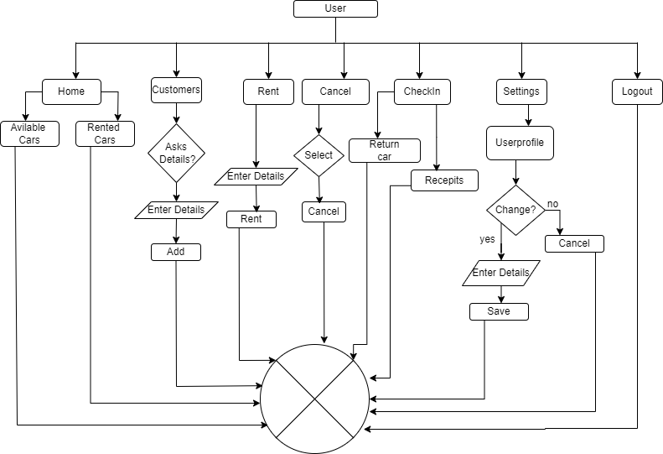
FLOWCHART III:

Slide 12
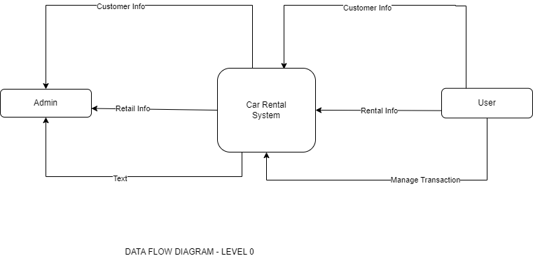
DFD 0:

Slide 13
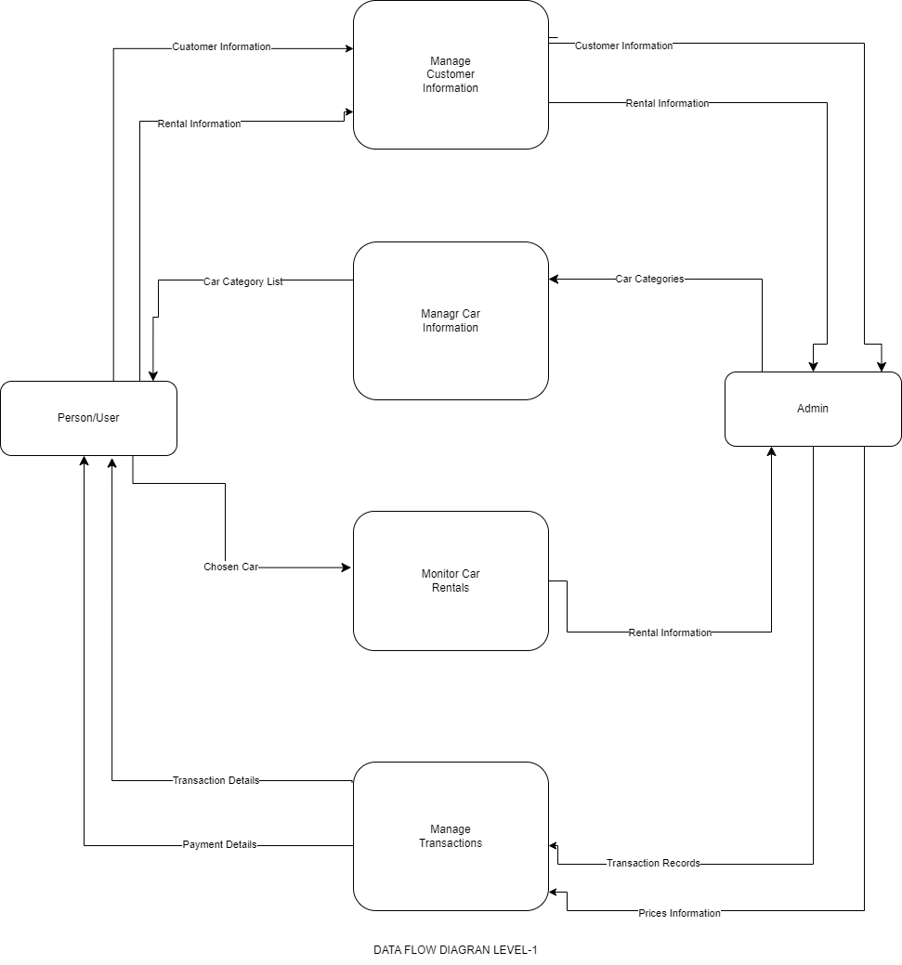
DFD 1:

Slide 14
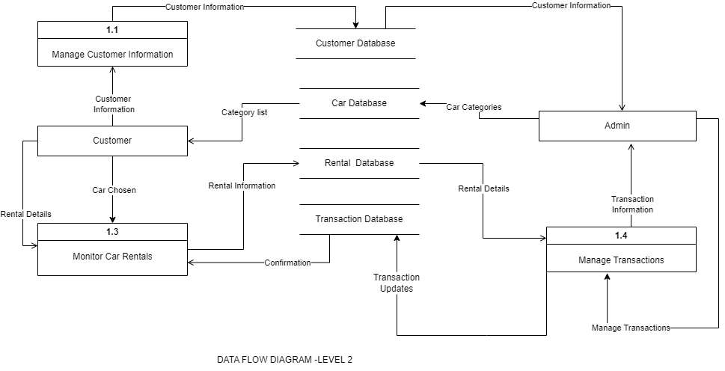
DFD 2:

Slide 15
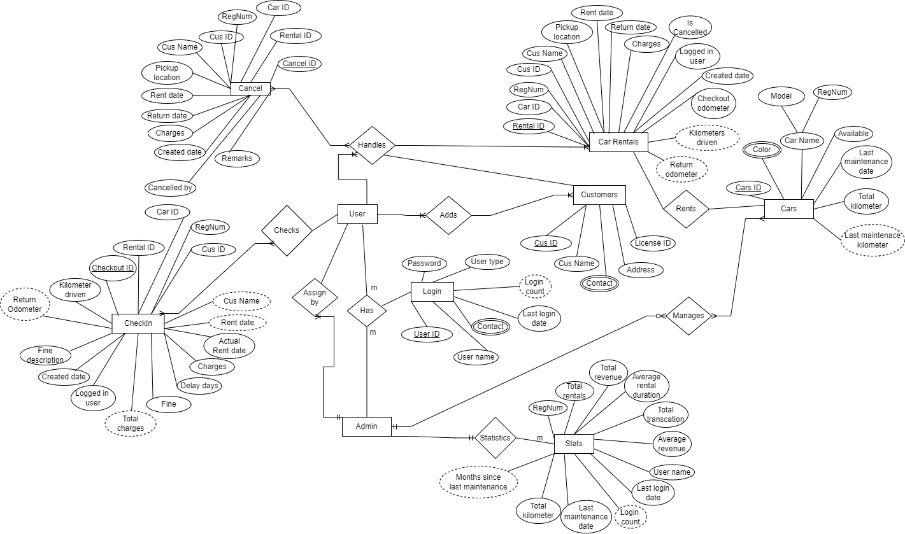
Er- Diagram:

Slide 16
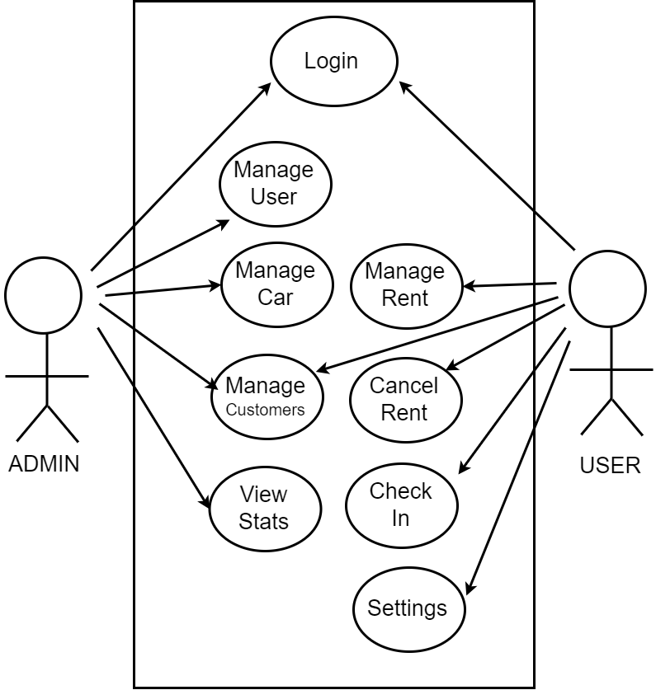
Use Case Diagram:

Slide 17
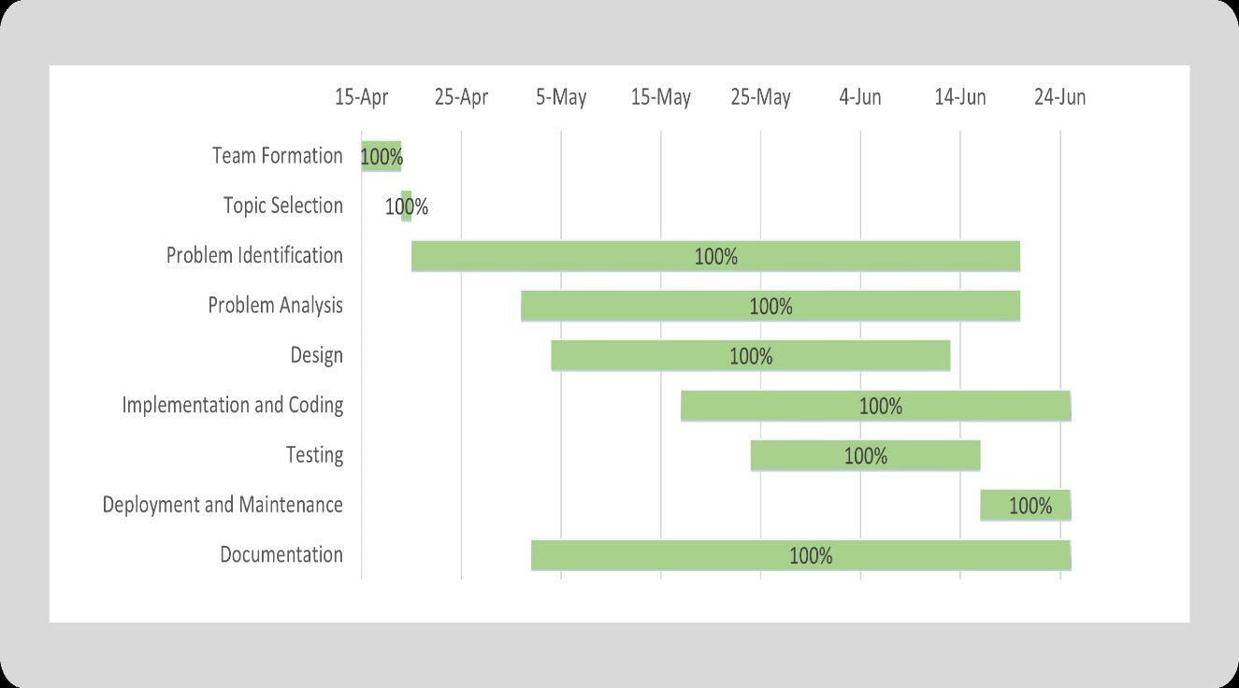
GANTT CHART:

Slide 18
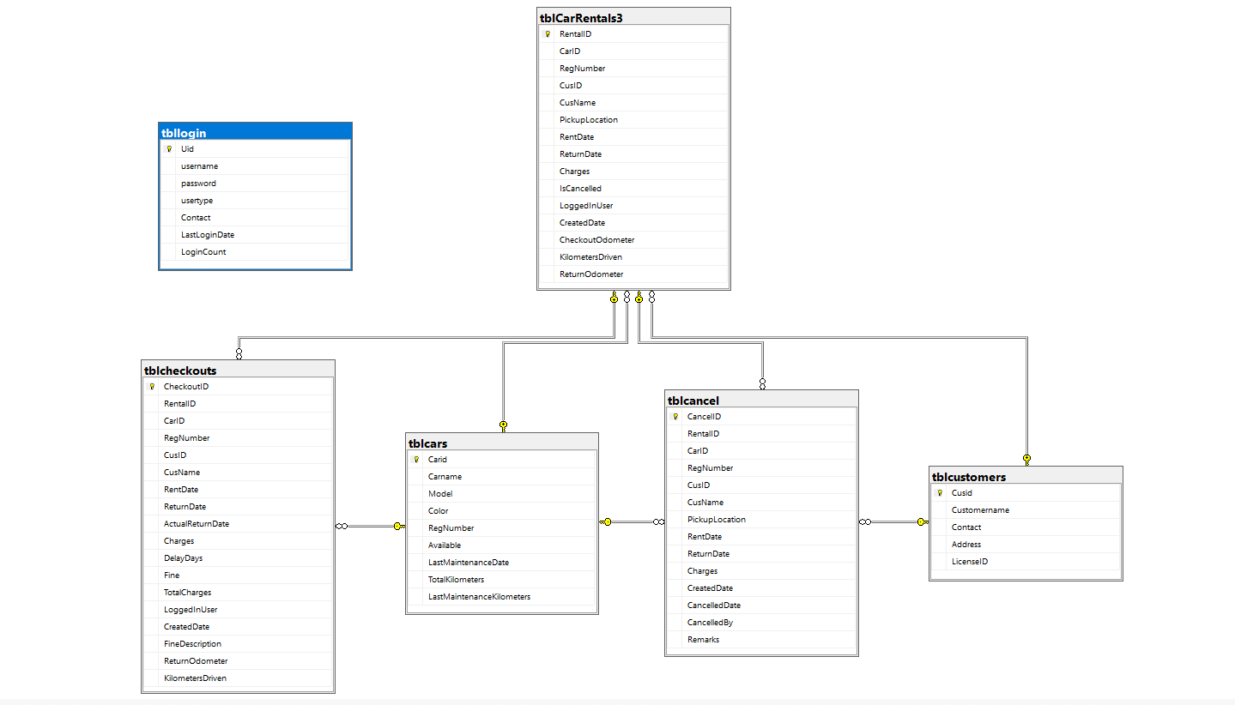
Database Schema:

Slide 19
DEMO

Slide 20
PROJECT’S RESULTS​
What are the functions achieved by our project?
What Problems have been solved by our project?
What requirements have been met?
What makes our Project different from others?

Slide 21
FUTURE ENHANCEMENTS
Enhanced UI/UX
Data Backup and Security
Driver Verification and License Management
Advanced Car management features

Slide 22
THANKYOU
WE’RE OPEN FOR Q&A

